Slide 1
Working principle of Sound card.
Md. Fazle Rabbi
ID:16CSE057

Slide 2
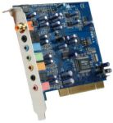
Sound Card
A sound card (also referred to as an audio card) is a peripheral device that attaches to the ISA or PCI slot on a motherboard to enable the computer to input, process, and deliver sound.
A sound card is a computer expansion card that facilitates the input and output of audio signals to and from a computer under control of computer programs.

Slide 3
How The Sound Card Works
The sounds that we use and make are referred to as analog. The computer cannot read these signals so it converts the analog of something into electric impulses. These impulses are then interpreted by your sound card, which is played at the click of a mouse.

Slide 4
Types of Sound Cards
8 bit: the 8 bit sound card has a lower quality than a 16 bit or 32 bit sound card, but has less requirements for the system's hardware.
16 bit: the 16 bit sound card is of the next higher quality because of its storage capacity. This card creates a more accurate sample of the signal than the 8 bit card and its sample rate, or speed, is also another factor in higher resolution sampling.
32 bit: the 32 bit card consists of the highest quality of sound cards, but also requires more of the system's resources and is more costly.

Slide 5
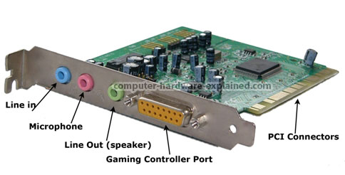
Ports and Connections
Line-In: This port is where sound from an external source enters the card, such as recording from a tape recorder. On many sound cards this port is light blue. Line-Out (Speaker Out or Front): Where sound is output; usually to headphones or stereo speakers. On many cards this port is lime green. Mic: Microphone port; usually pink.
Game port / MIDI: The MIDI port is a dual-purpose port used to connect a joystick, electronic instruments or a synthesizer. This port is usually yellow/gold.

Slide 6
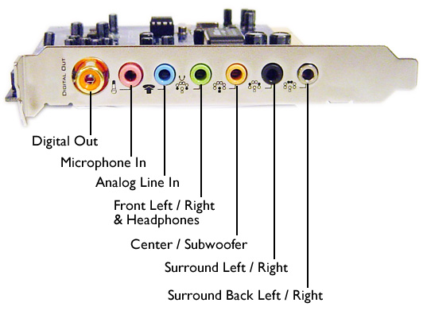
Other Part
Right-to-left speaker: Analog line level audio output for a special panning. Usually this port is brown.
Rear stereo: Analog line level audio output for surround speakers. Usually its black.
Center channel speaker: Analog line level audio output for center channel speaker and subwoofer.
SPDIF Port: Stands for Sony/Philips Digital Interface - with a SPDIF port, everything is digital, from the input of sound to the output to the speakers.

Slide 7
Sound Card Component
A digital-to-analog converter (DAC)
The most basic sound card is a printed circuit board that uses four components to translate analog and digital information:
An analog-to-digital converter (ADC)
An ISA or PCI interface to connect the card to the motherboard
Input and output connections for a microphone and speakers

Slide 8
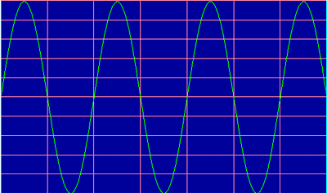
Analog vs Digital
Sounds are analog - they are made of waves that travel through matter. People hear sounds when these waves physically vibrate their eardrums. It is a signal that is continuous.
Sounds are digital - Computers, however, communicate digitally, using electrical impulses that represent 0s and 1s.

Slide 9
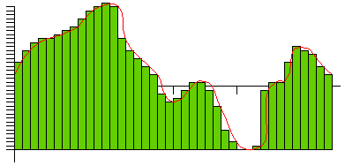
ADC and DAC
Analog-to-Digital Converter
The ADC translates the analog waves of your voice into digital data that the computer can understand.
The number of measurements per second, called the sampling rate, is measured in kHz. The faster a card's sampling rate, the more accurate its reconstructed wave is.

Slide 10
Digital-to-Analog Converter
If you were to play your recording back through the speakers, the DAC would perform the same basic steps in reverse.
With accurate measurements and a fast sampling rate, the restored analog signal can be nearly identical to the original sound wave.

Slide 11
Reduction in Sound Quality
The physical process of moving sound through wires can also cause distortion.
Total Harmonic Distortion (THD), expressed as a percentage .
Signal to Noise Ratio (SNR), measured in decibels
For both THD and SNR, smaller values indicate better quality. Some cards also support digital input, allowing people to store digital recordings without converting them to an analog format.

Slide 12
Sound Card Problems
Driver Issue
Speaker Issue
3.Computer Slows down
4.Motherboard Compatibility

Slide 13
THE END

